Slide 1
Regional MLS
Upcoming Changes and Required Fields

Slide 2
Why a Regional MLS?
Eliminating geographic boundaries
Creates a seamless search for REALTORS®
Eliminates the need for brokers to manage and pay for multiple data feeds
Produces better statistics with unified regional information
Increases advanced training opportunities
Follows NAR and State Association goals
Increases the ability to enhance the MLS system

Slide 3
December 4, 2018
New fields will be visible in Paragon
These new fields will be marked in BLUE on the new input forms
Fields that have been renamed and will be required will be marked GREEN on the new input forms

Slide 4
December 4, 2018
Public Remarks and Agent Remarks are increasing from 500 to 1000 Characters
‘No Show’ listings will not accumulate DOM until the ‘Available to Show Date’
Photos are increasing from a limit of 36 to 99
Additional counties are being added via CRS Data: Filmore, Fage, Hale, Saline, York, Madison, Plate and Jefferson – increasing the total number available from 12 to 20

Slide 5
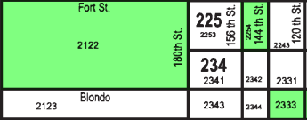
January 7, 2019
The added required fields from December 4th will now be required
With this, any change made to an existing listing or the addition of a new listing will trigger the new required fields to be completed
The area map will be retired
Members can use the Google mapping feature built into Paragon

Slide 6
February 25, 2019 & March 25, 2019
February 25, 2019
We are expecting to see the consolidated data from Lincoln and Omaha in Paragon
Any data accuracy or mapping issues will be resolved and the consolidation team will check for any flaws in the system operation
March 25, 2019
The final cut-over process is expected to conclude and the Great Plains Regional MLS system will be operational with all listings from both markets

Slide 7
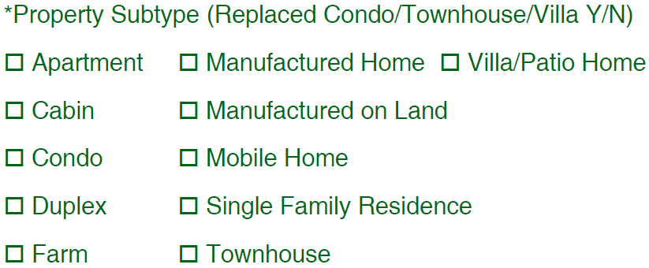
New Residential Fields – Standard
‘Property Attached’ has been updated to a Yes/No field
‘Property Subtype’ will be changing to a picklist replacing the Condo/Townhouse/Villa YN field and will include the following options:

Slide 8
New Residential Fields – Standard
‘Senior Living (55+)’ has been added as a Yes/No field and will be required beginning January 7th
‘Post Direction’ field has been added to the property address.

Slide 9
New Residential Fields – Standard
‘Photos Provided By’ has now been added as a drop down field with three options and will be required beginning January 7th
‘Lot Included in Price’ has been added as a Yes/No field and will be required beginning January 7^{th.}

Slide 10
New Residential Fields – Standard
A Yes/No option has been created for ‘SID’ and the ‘SID Number’ field will only be required if ‘Yes’ is selected.
The SID Yes/No field will be required beginning January 7th.

Slide 11
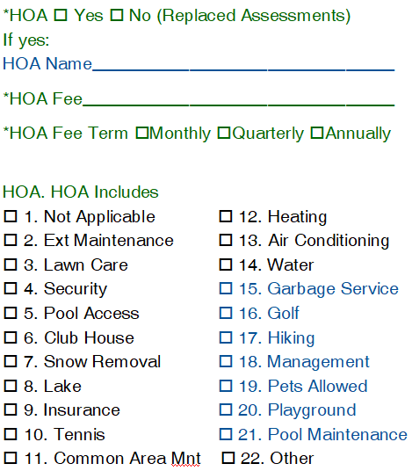
New Residential Fields – General
‘Assessments’ has been updated to ‘HOA’
It is currently required and will remain required
If Yes is selected, supplementary questions will follow

Slide 12
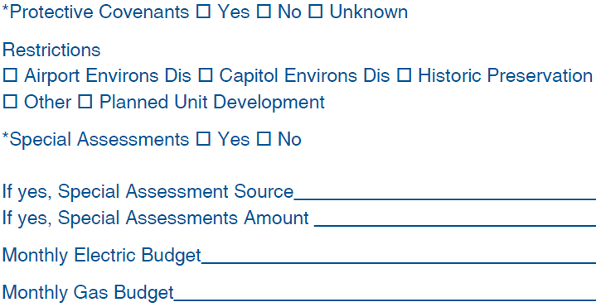
New Residential Fields – General

Slide 13
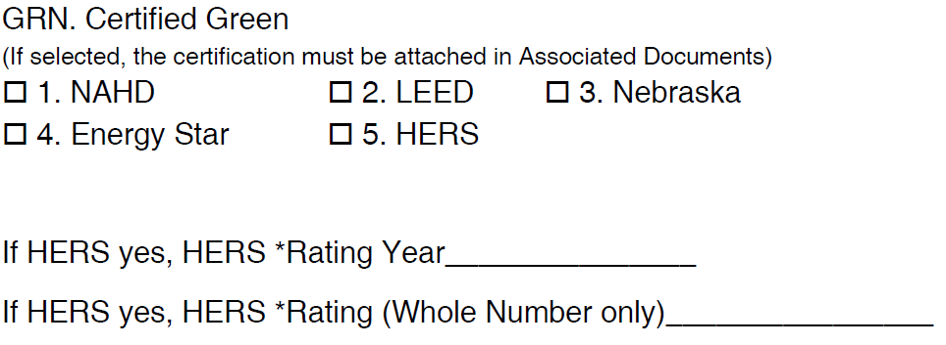
New Residential Fields – General
‘Green Fields’ Features have been moved above ‘Legal Description’ and now incorporate an option for HERS with supplementary questions if HERS is selected.
‘Lot Dimension Source’ has been added as a picklist field and will be required beginning January 7th.

Slide 14
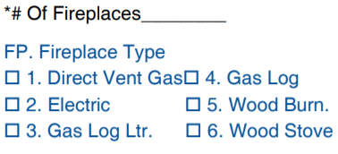
New Residential Fields – General
‘Fireplace Type’ features picklist has been added under the existing ‘# of Fireplaces’ field.

Slide 15
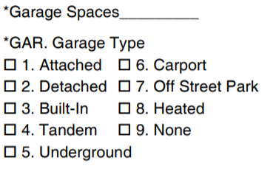
New Residential Fields – General
The ‘Garage Type’ features picklist has been moved under the ‘Garage Spaces’ field.

Slide 16
New Residential Fields – General
‘SqFt Source’ picklist has been added and will be required beginning January 7th.
‘Basement Features’ picklist has been added and will be required beginning January 7th.

Slide 17
New Residential Fields – General
‘Tax Database ID’ picklist has been added.
‘Model Name’ and ‘Builder’ fields have been moved under ‘Model Home’ Yes/No field.

Slide 18
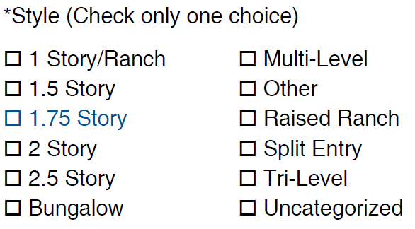
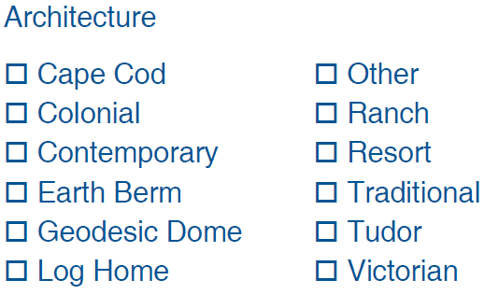
New Residential Fields – General
The existing ‘Style’ picklist has been divided into ‘Style’ and ‘Architecture’.
1.75 Story has been added to ‘Style’

Slide 19
New Residential Fields – General
‘Bonus’ text field has been added under ‘Commission Compensation Code’

Slide 20
New Residential Fields – General
Neigh Rev Strat Area’ Yes/No field has been added.
NIFA Target Area’ Yes/No field has been added and will be required beginning January 7th. (Nebraska Investment Finance Authority)
NIFA Target Area Omaha Map

Slide 21
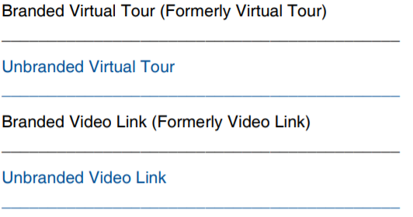
New Residential Fields – General
‘Unbranded Virtual Tour’ field and ‘Unbranded Video Link’ have been added.

Slide 22
Room Dimensions and Descriptions
*Please note, the order of levels have changed. They will now be ordered:
Main floor, 2nd floor, 3rd floor, Below Grade
*Some descriptions fields (previously under ‘Features’) have moved underneath their corresponding fields.
i.e. ‘Living Room Descriptions’ have moved underneath ‘Living Room Size’ and ‘Living Room Level’
*Room fields will be ordered by size, then level, then description.

Slide 23
Room Dimensions and Descriptions

Slide 24
Room Dimensions and Descriptions
‘Great Room’ and ‘Office’ have been moved out of ‘Other Room Names’
‘Dining Room’ has been split into ‘Formal Dining’ and ‘Informal Dining’
‘Kitchen 2’ has been added
‘Bedroom 5’ and ‘Bedroom 6’ have been added

Slide 25
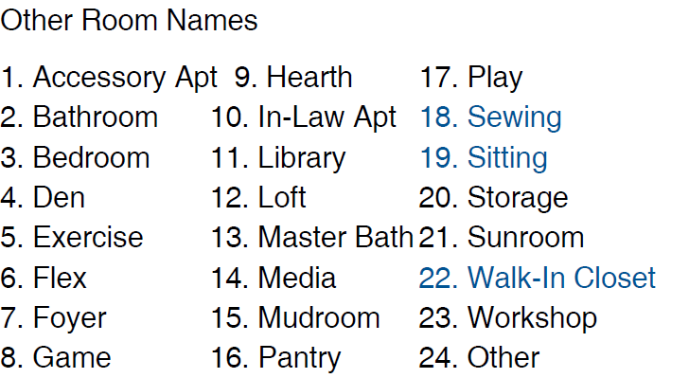
Room Dimensions and Descriptions
‘Sitting’, ‘Sewing’ and ‘Walk-In Closet’ have been added to ‘Other Room Names’.

Slide 26
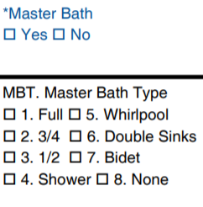
Room Dimensions and Descriptions
‘Master Bath’ Yes/No field has been added underneath ‘Other Room 5’ and will be required beginning January 7th.
‘Master Bath Type’ picklist has been moved under ‘Master Bath’ Yes/No field.

Slide 27
Showing Information
A new section titled ‘Showing Information’ has been added to replace the ‘Showing Instructions’ list under ‘Features’.
This gives the opportunity to add additional showing information or instructions.
Directions to Property’ have been moved to this section with 250 available characters.
Showing Phone Number will be a required field beginning January 7th.

Slide 28
Showing Information
‘Showing Contact Type’ has been added as a picklist and will be required beginning January 7th with the options:
Agent
Broker
Other
Seller
Showing Service
There is an added free field for ‘Showing Instructions’ with 500 available characters.

Slide 29
Showing Information

Slide 30
Features
*Please note the order of this section has changed due to moving feature fields.
*’Handicap Modified’ has been updated to ‘Accessible’

Slide 31
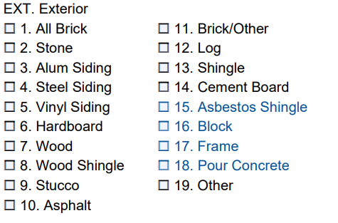
Features
‘Exterior’ has added new options to include:
Asbestos Shingle
Block
Frame
Pour Concrete

Slide 32
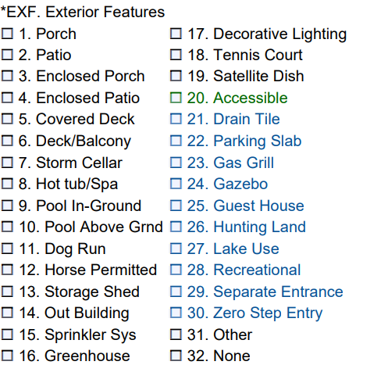
Features
‘Exterior Features’ has added new options to include:
Drain Tile
Parking Slab
Gas Grill
Gazebo
Guest House
Hunting Land
Lake Use
Recreational
Separate Entrance
Zero Step Entry

Slide 33
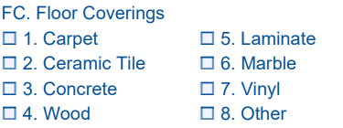
Features
‘Floor Coverings’ has been added under ‘Fence’ and will include:
Carpet
Ceramic Tile
Concrete
Wood
Laminate
Marble
Vinyl
Other

Slide 34
Features
‘Foundation Details’ has been added under ‘Floor Coverings’ and will be required beginning January 7th. Options include:
Poured Concrete
Slab
Concrete Block
Stone
Tile
Crawl Space
Other
None

Slide 35
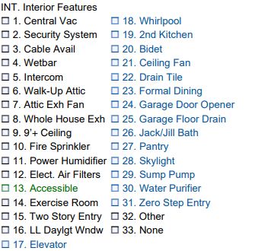
Features
‘Interior Features’ have been updated to include:
Elevator
Whirlpool
2nd Kitchen
Bidet
Ceiling Fan
Drain Tile
Formal Dining
Garage Door Opener
Garage Floor Drain
Jack and Jill bath
Pantry
Skylight
Sump Pump
Water Purifier
Zero Step Entry

Slide 36
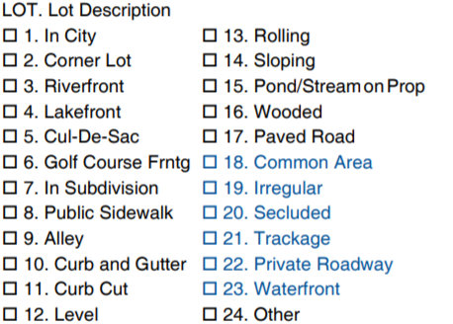
Features
‘Lot Description’ has been updated to include:
Common Area
Irregular
Secluded
Trackage
Private Roadway
Waterfront

Slide 37
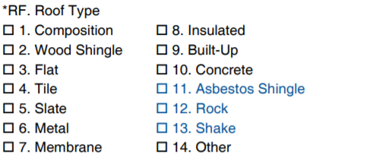
Features
‘Roof Type’ has been updated to include:
Asbestos Shingle
Rock
Shake

Slide 38
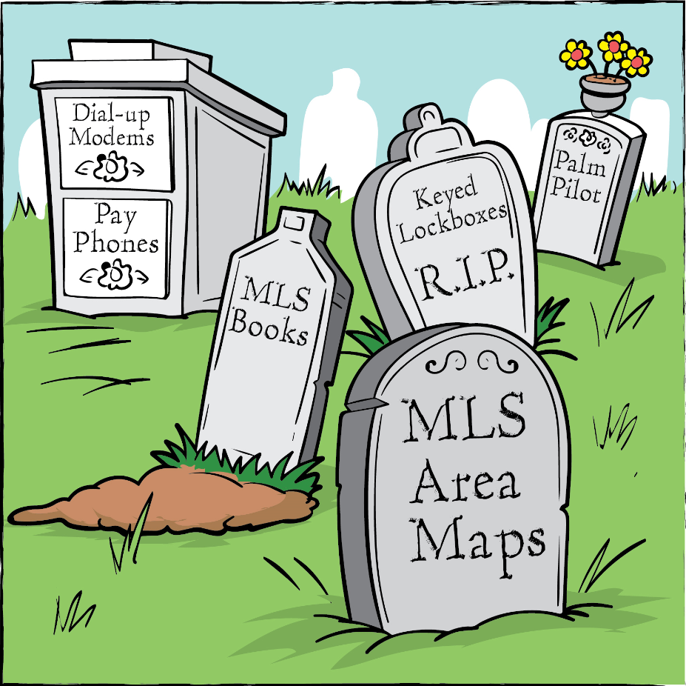
Takeaways
December 4:
New fields added
January 7:
New required fields now required
Input Forms will be updated as needed – Print only what is needed
Visit www.OmahaREALTORS.com/RegionalMLS regularly to make sure you have the most recent forms and communications.

Slide 39
Takeaways
January 7th the Area Map will be retired
Members can use the Google mapping feature built into Paragon
Please use the link below to access a how-to video, recorded webinar, and screenshot instructions on preforming map searches.
http://paragonconnect.paragonrels.com/paragon/search/item/148-basic-search

Slide 40
Questions?
For any further information or questions please feel free to contact the MLS Staff:
Denise Mecseji – MLS Manager
402-619-5554
Denise@OmahaREALTORS.com
Dakota Ghegan – MLS Administrator
402-619-5556
Dakota@OmahaREALTORS.com

